Slide 1

NPM && node modules
By Naor Tedgi (Abu Emma)
@ntedgi

Slide 2
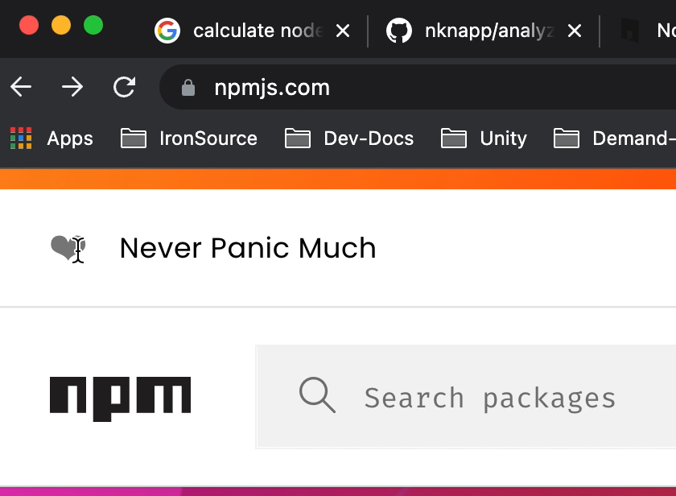
NPM - default package manager for the JavaScript runtime environment Node.js

Slide 3




NPM - equivalent
Yarn
PNPM
Turbo.

Slide 4
Package.json
Every node module / app have to define package.json
Package.json contains
Data about third party packages
Meta data about the package email , repo etc..
Requirement [node version,platform etc..]
Build test,run excution scripts…

Slide 5
Semver X.X.X
Given a version number MAJOR.MINOR.PATCH, increment the:
MAJOR version when you make incompatible API changes
MINOR version when you add functionality in a backwards compatible manner
PATCH version when you make backwards compatible bug fixes
1 ) Function fetch (url,options={ }){
…
}
Patch - fix bug inside function
Minor - add property to options (options.timeout)
Major – Function fetch(options) =>options.url = https://....

Slide 6
Prefix symboles
Caret (^) — a caret is the default prefix you get from npm after installing a new package. It gives you the highest minor version available with its highest patch version.
Tilde (~) — a tilde prefix will only promote patch versions, meaning that you’ll get the highest patch version for your current minor.

Slide 7
Problem with prefix symboles
Every time we running NPM I were getting the version compatible package
If there is a minor change deploy to a package we download it
This could lead to inconsistency

Slide 8
Package.json lock
To keep our dependicies consistent after npm install package.json-lock file created with a hard coded version need to be instaled
always push this file to you git repo!
If there is diffrence between package.json and package.json lock npm CI will throw an error
Run much faster if there is’nt any node_modules libery exist

Slide 9

10 Things I Regret About Node.js - Ryan Dahl - JSConf EU

Slide 10
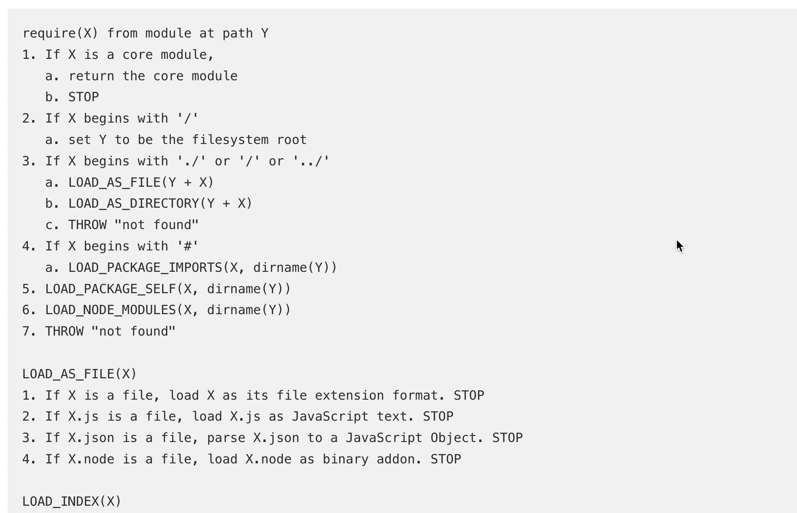
Node Require Algorithem
Notes:
hostingתראה את התיקייה עם ה
תסביר על בעיית ה singeltone

Slide 11
Npm install psoudo code
For Each package in package.json
get dependicy from corrospund registry (npm , jfrog….)
select the compitable package by semver to current sub tree
Decide in with tree level to install each package
Download each package By tree path
Notes:
hostingתראה את התיקייה עם ה
תסביר על בעיית ה singeltone

Slide 12
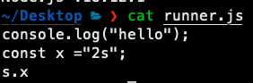
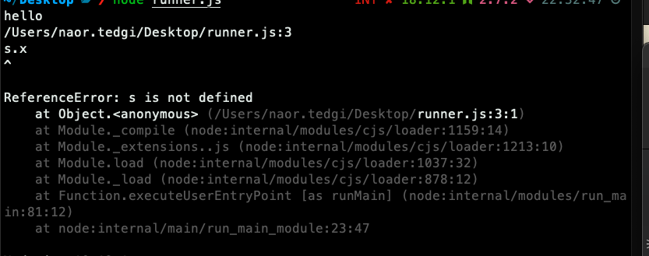
problem 1 – node is interpreted
Code get executed and compiled for each line
Cant optimize like AOT compilations and reuse classes and namespaces

Slide 13
problem 1 – node is interpreted
we basiclly need to recursivlly get all our dependices and third party depndicies as well. And getting a lot of packages more then once
For example semver package

Slide 14
problem 2 – lack of conventions
There isn’t any validation of what kind of data your going to deploy with your package code src files
For example object.assign package
node-prune and ModClean.
Reduce platform js 70MB

Slide 15
Why we even care?
performance – an application that is light and runs faster, takes up fewer resources so it works more efficiently during development,
costs – some light apps require fewer resources which means that the infrastructure costs drop and you save up a lot of money

Slide 16
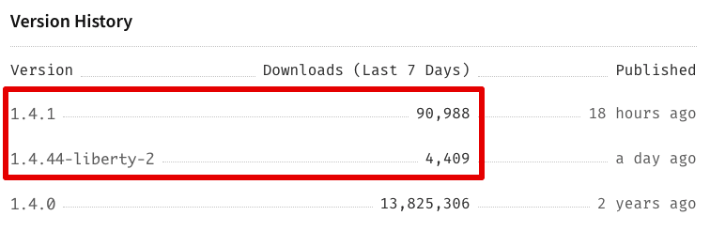
problem 4 – open source security risks colors.js
The colors open source npm package receives over 20 million downloads a week and is a key ecosystem project with JavaScript and Node.js developers, powering a great set of projects. GitHub records show that the colors project is used within more than 4 million other projects, and npmjs.org shows this npm package is dependent upon by 18,962 other packages.

Slide 17
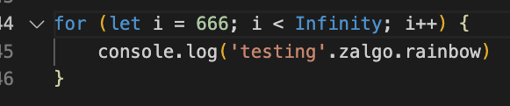
problem 4 – open source risks colors.js

Slide 18
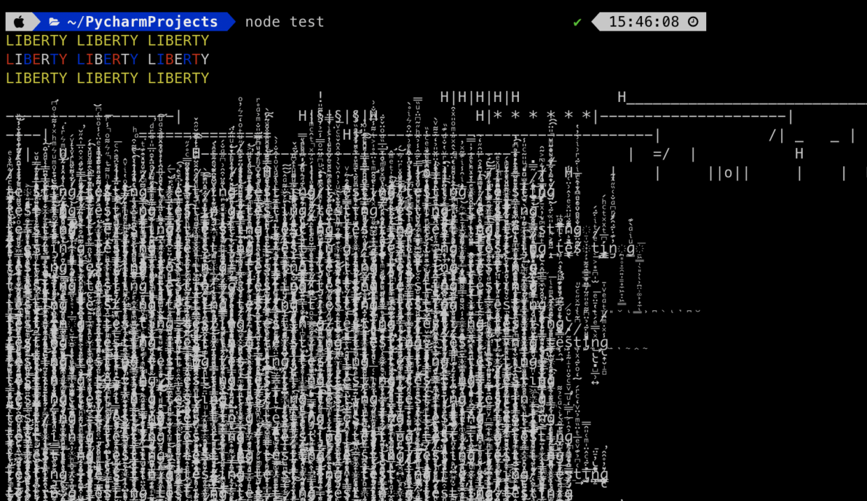
problem 4 – open source risks colors.js

Slide 19
problem 4 – open source risks Cybercriminals targeted users of packages with a total of 1.5 billion weekly downloads on npm
https://www.mend.io/resources/blog/cybercriminals-targeted-users-of-packages-with-a-total-of-1-5-billion-weekly-downloads-on-npm/

Slide 20
problem 4 – open source risks protest ware
https://github.com/medikoo/es5-ext/blob/main/_postinstall.js

Slide 21
What we can do to solve this??

Slide 22
Node eco system
Add more standards
Node 18 (fetch) instead of (node-fetch axios got ..)
Node 18 (node:test - tap) instead of (mocha ,jest, chai …)
Node 19 (--watch) instead of nodemon
Node 20 sinon spies mock

Slide 23
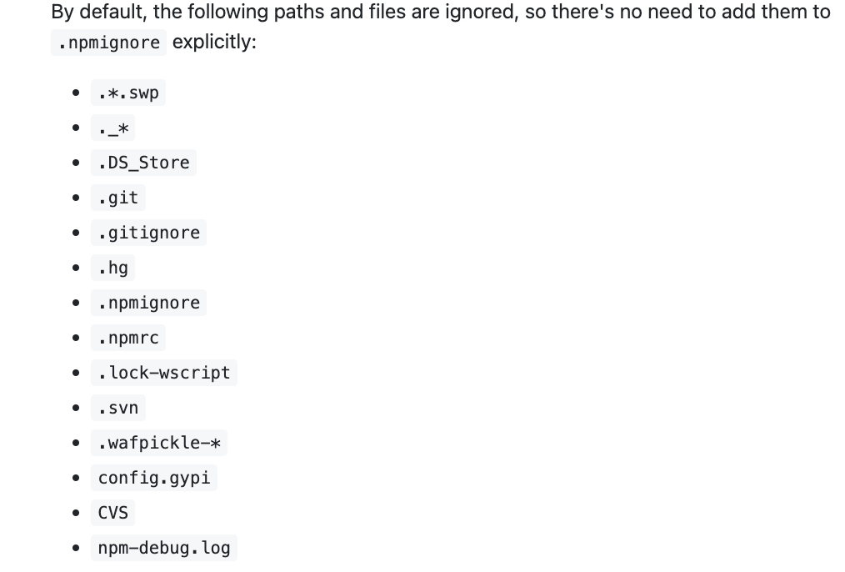
NPM eco system
Npm ignoring files

Slide 24
Open source eco system
Extracting single fucntion as node modules
for example https://www.npmjs.com/search?q=lodash

Slide 25
Use production flag
use `–production` flag on npm install. It will skip all of the devDependencies and use production ones only.
In platform js
Without flag our node_module size is 732 MB
With this flag 461 MB

Slide 26
What should we do from now?
First try rewriting code nativly (uuid buffer64)
Delete unused dependicies !
https://github.com/ironsource-mobile/platform-js/pull/1015/files#diff-2707fc9393025d5c0b98b2cab6f0995fcf60c27fba22402d5fa1f920a5c7909e
Check if we all ready got a package before installing new one
(we use 3 different http clients)
Try to find a tree shaked libery

Slide 27
Happy Coding ..
https://github.com/ntedgi/Demand-TechTalks

